Slide 1
Online Homestay and Hotel Booking
Guidance By:
Prof. Snehal Somvanshi

Slide 2
Group No. 17
Ashwini Raut (230943020016)
Aditi Helaskar (230943020034)
Kajal Dudhe (230943020040)
Shivani Natu (230943020087)
Vidya Pawar(230943020112)

Slide 3
Project Overview
In Existing Hotel booking Systems we do not get options of home stays and home accommodation. Home stays are preferred by many people when visiting regions like Konkan. Home stays offer more enriched experience about local culture and cuisines. So, we will offer home stay bookings along with hotel bookings to enhance customer experience.
Numerous platforms facilitate hotel reservations across various destinations. In our system, we aim to encompass local hotels and home stays, extending our reach to include home stays in order to support small-scale accommodations . Business owners can register with us, gaining access to a platform that showcases their establishment and aids in attracting more customers.

Slide 4
Users of System
Admin
Owner(Homestay/Hotels)
Customers

Slide 5
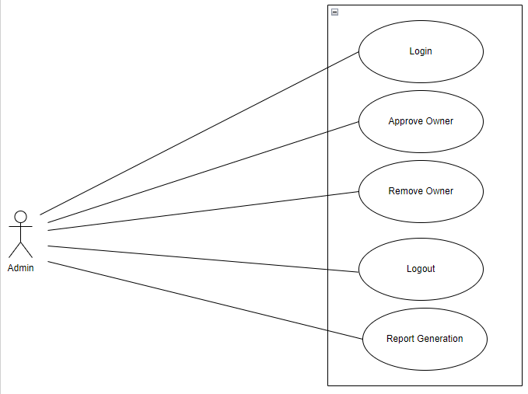
Use case Diagrams
1.Admin

Slide 6
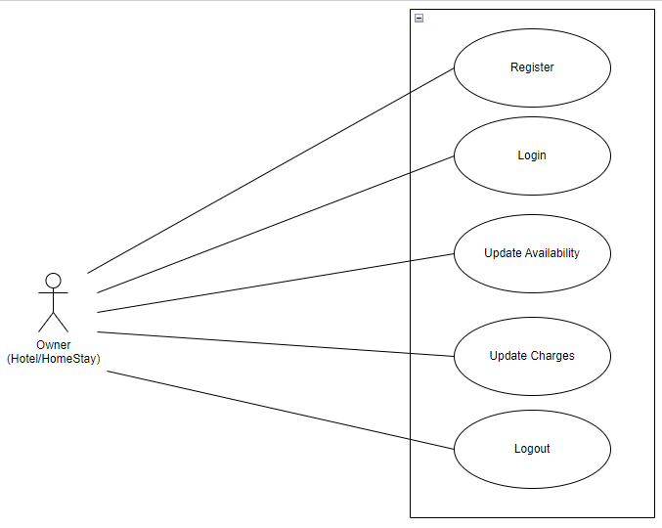
2.Owner

Slide 7
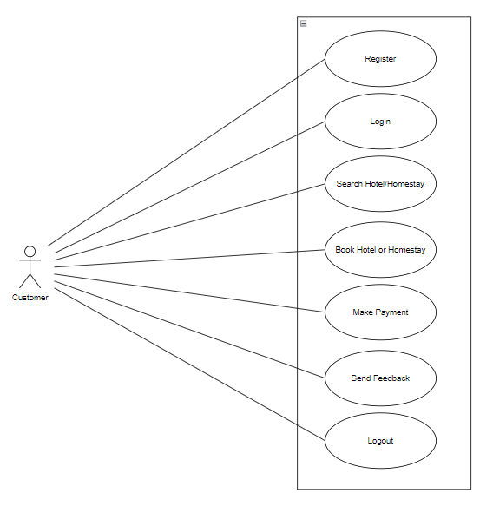
3.Customer

Slide 8
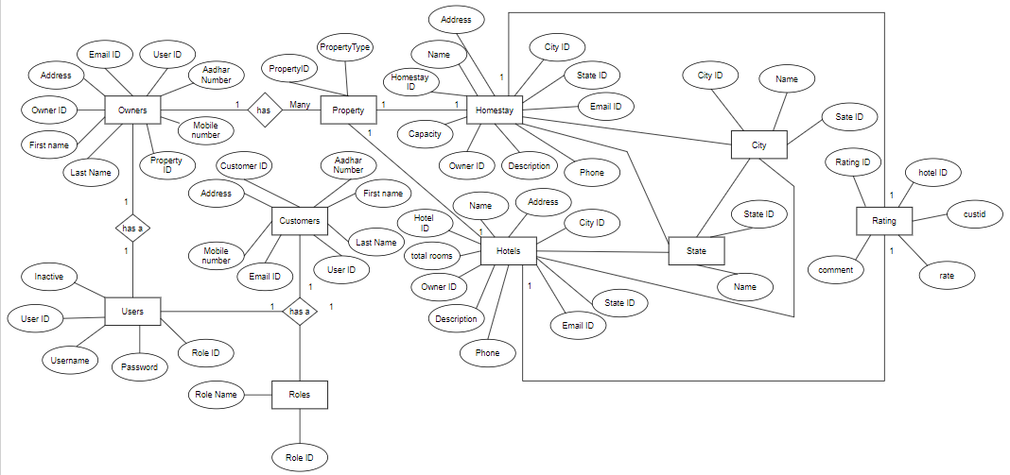
ER Diagram

Slide 9
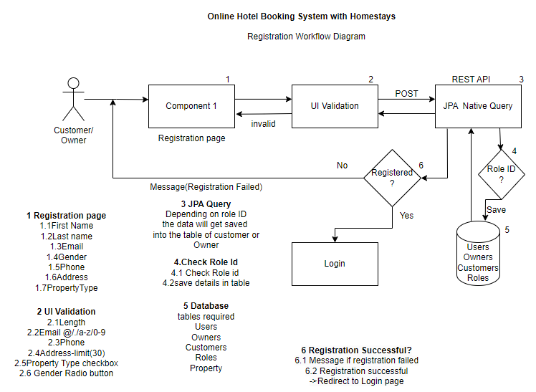
Registration Workflow Diagram

Slide 10
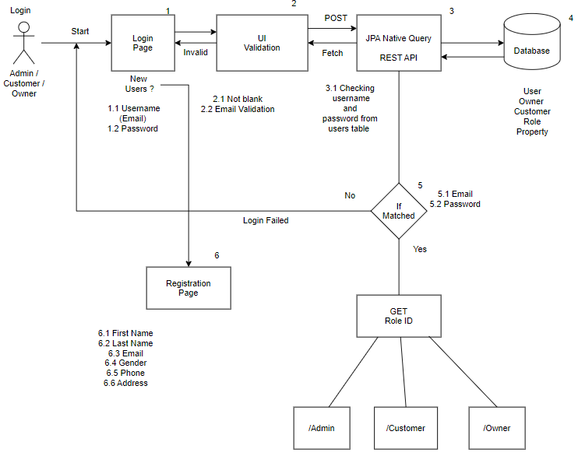
Login Workflow Diagram

Slide 11
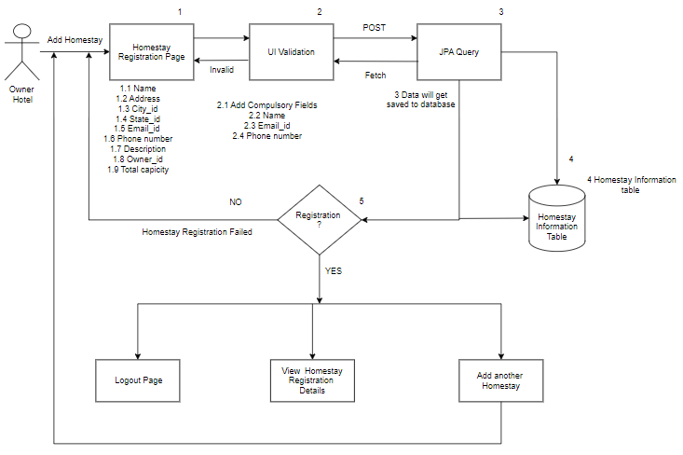
Homestay/Hotel Registration Workflow

Slide 12
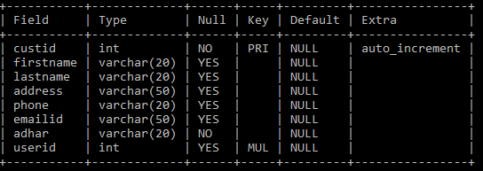
Database Design
Customer

Slide 13
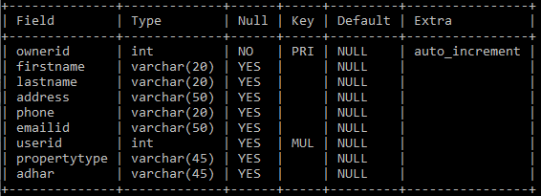
Owner

Slide 14
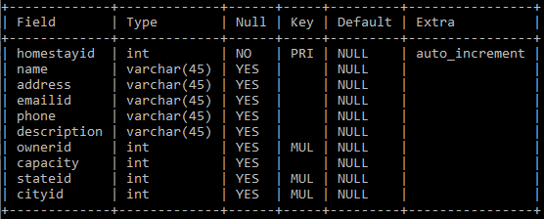
Homestay

Slide 15
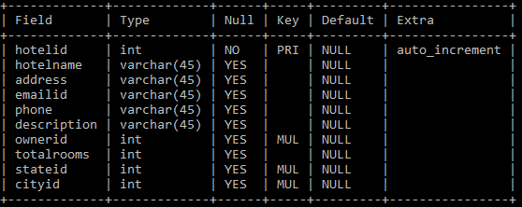
Hotel

Slide 16
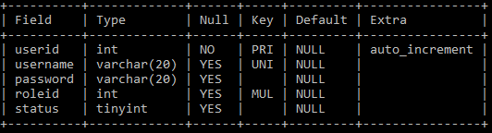
Users

Slide 17

States

Slide 18
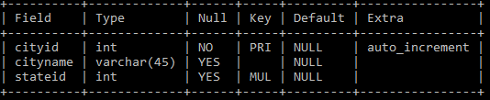
City

Slide 19
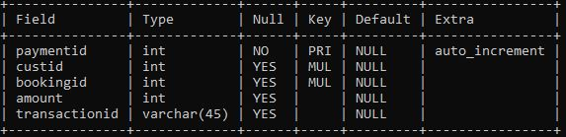
Payment

Slide 20
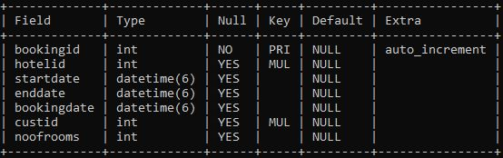
Booking

Slide 21
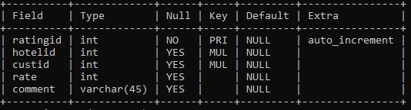
Rating

Slide 22
Project Architecture
3 tier architecture
Front End: React js
Backend: MySQL database
Middle wear: REST API using Spring Boot

Slide 23
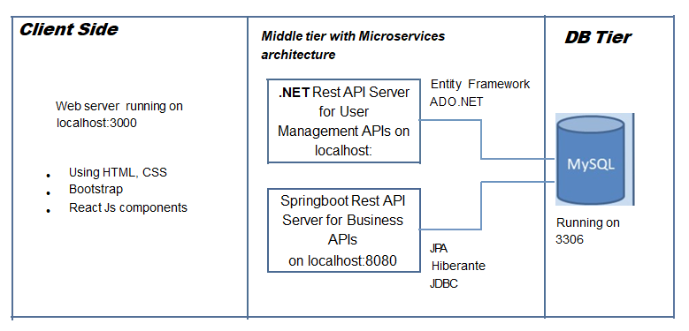
My role and contribution

Slide 24
Project Methodology
Agile Methodology
3 sprints(phases) of our project
Registration and Login of Users
CRUD Operations
Transactions of the system

Slide 25
Future Expectations
Fetching Reviews from customers who have visited Hotels / Homestays.
Taking and Updating offers from Owners and Displaying it for Customers.
Remove Hotel/Homestays which are not authentic.

Slide 26
Your Experience/Lessons learnt
1. Team work
2. Hands on experience of Springboot and React js
3. Git Hub

Slide 27
THANK YOU!

